Slide 1
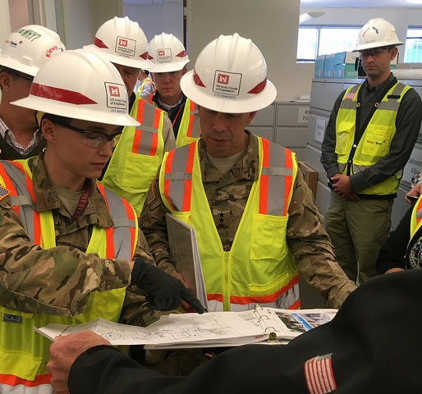
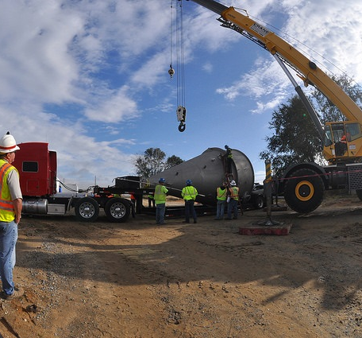
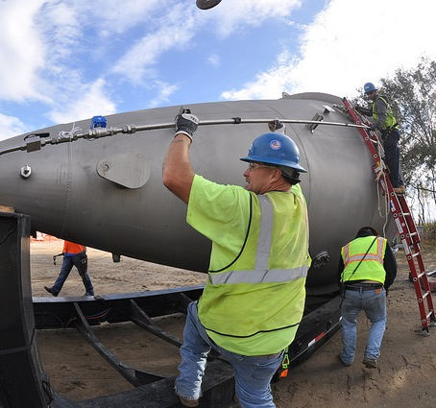
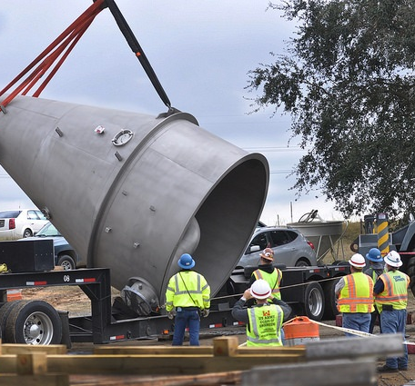
Tulsa district cost engineering processes & trends same cost estimating workshop
Amber Lanphere, CCC
Team Lead, Cost Engineering
Tulsa District
Date: 19-Mar-19
amber.d.lanphere@usace.army.mil
918-669-7033

Slide 2
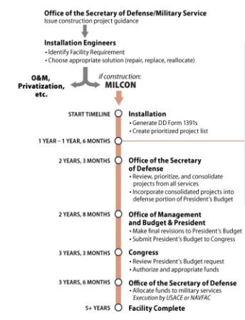
Introduction to milcon estimating
Two types of estimates: budget vs. current working estimate (CWE)
Budget estimates
    Created by installations (BCEs)
    Documented in DD 1391 forms
    Budget becomes appropriation
    Appropriation has a “programmed amount”
    Figure 1 shows the MILCON budgeting process
Figure 1. MILCON Budget Process

Slide 3
Milcon budget estimates
Validation of MILCON budget estimates
    Different process for Army vs. Air Force
    Both have planning charrettes where the DD 1391 is validated
    USACE involved in DD 1391 validation
    Army allows USACE to update the ENG 3086 form just prior to beginning design
    The ENG 3086 is used to update the DD 1391 (assuming ACSIM approves the changes)
Once design begins, the DD 1391 form is finalized and any changes require formal approval possibly all the way through Congress
    Above threshold requirements (ATR) reprogramming required for projects requiring funds in excess of the programmed amount in addition to either $2M or 25% of programmed amount (whichever is less)
    Reprogramming at Congressional level
    Reprogramming causes significant schedule delays and adds significant planning and development costs
DD 1391 Form
    Project requirements (SOW)
    Programmed amount (PA)

Slide 4
MILCON Current working estimates (cwe)
Current Working Estimates
    Development begins as soon as design or RFP development begins
    Submittal required with each design or RFP submittal
    May be developed in-house (USACE) or with an A-E firm
    Required to ensure that design is within the PA documented in the DD 1391 form
    If CWE exceeds the PA, the design team must develop COAs (halt design and seek further guidance, develop options for the SOW, redesign, reprogram through Congress)
The CWE eventually becomes the Independent Government Estimate (IGE) just prior to receiving contractor proposals for either the design-build or design-bid-build project.

Slide 5
Why do we develop independent government estimates?
Independent Government Estimates (IGEs) – Required by Federal Acquisition Regulation (FAR) 36.203 -- Government Estimate of Construction Costs and 36.605 -- Government Cost Estimate for Architect-Engineer Work for construction contracts, service and supply contracts, A-E contracts, and contract modifications.
Assists the government in determining a fair and reasonable price.

Slide 6
how does contracting division utilize ige’s?
USACE Acquisition Instruction (UAI) Part 5136, 25 January 2017– Construction and Architect-Engineer Contracts:
“Award of a contract for military construction shall be approved by the Center Director/District Commander when the lowest qualifying bid/proposal exceeds the Government's estimate by more than 15%.” Rarely will the KO recommend the Commander to award contracts above 15% threshold.
“Military installation support for Operations & Maintenance (SRM) construction. Installation Commander or designee approval shall be obtained prior to award of a contract if the proposed contract price exceeds the authorized amount on the project authorization document.” SRM projects no longer have a threshold for award.

Slide 7
Why should ige’s be important?
IGEs can significantly impact schedule, viability of a program, reprogramming (schedule & costs), and reputation and trust with stakeholders. Examples of issues that raise IGEs to higher levels of awareness:
    IGEs that exceed the Programmed Amount (DD 1391) on MILCON projects
    Differences between IGEs and bids exceed the percentage established for the contract cost limitations
    IGEs appear to be in line with the Programmed Amounts; however, bids come in much higher than the IGEs and Programmed Amounts
    Stakeholders are extremely concerned with accuracy of IGEs
  There is comparable variability in the average bidders proposal and our IGE relative to the awarded amount. Our Cost Estimators are just as good as those in industry when you look at our estimates related to the actual awards.
  ∑ = If we/industry are equally excellent at cost estimating, and we are still blowing PA amount, then maybe our efforts should shift to focusing on affecting the PAs!
  COL Hussin, Jan 2018 to LG Semonite & BG Owen

Slide 8
Tulsa district cost analysis
Tulsa District performed a cost analysis at the end of FY16 and FY17
    Analysis filters:
      Location
      Facility type (facility category: hangar, runway, dorms, etc.)
      Project delivery method (design-bid-build vs. design-build)
      Acquisition method (MATOC, SATOC, unrestricted, sole source, etc.)
      Project type (MILCON, Civil Works, Military O&M, etc)
    Analysis comparisons:
      IGE Totals vs. Award Totals
      PA Totals vs. Award Totals
      IGE Totals vs. Low Bidder/High Bidder/Average Bidder
      Range of Bids vs. IGE vs. Award Amount

Slide 9
Results – all projects
The IGEs developed by the SWT Cost Engineering Team are within +/-15% of the award amount 54.69% for all projects (64 total).

Slide 10
Results – project type

Slide 11
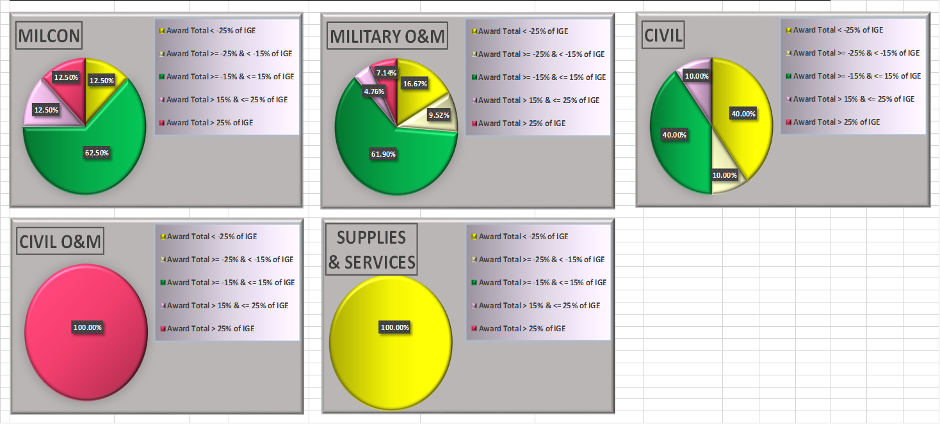
Results – project type (cont.)

Slide 12
Results – project construction type

Slide 13
Results – acquisition type

Slide 14
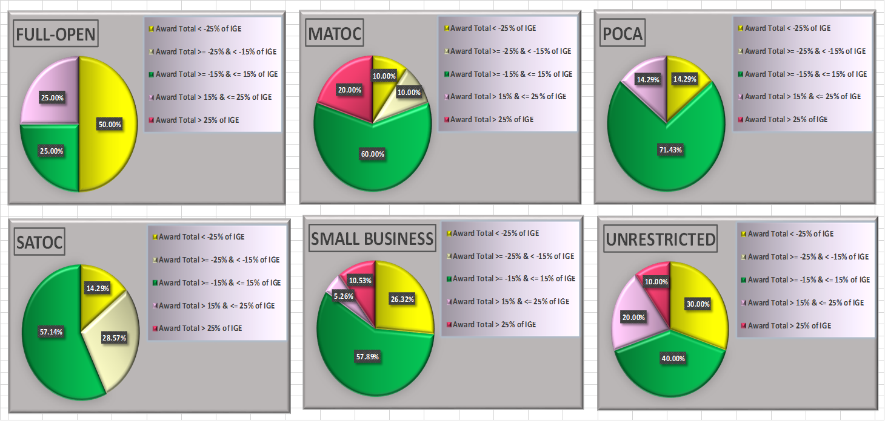
Results – acquisition type (cont.)

Slide 15
Results – award total vs. pa

Slide 16
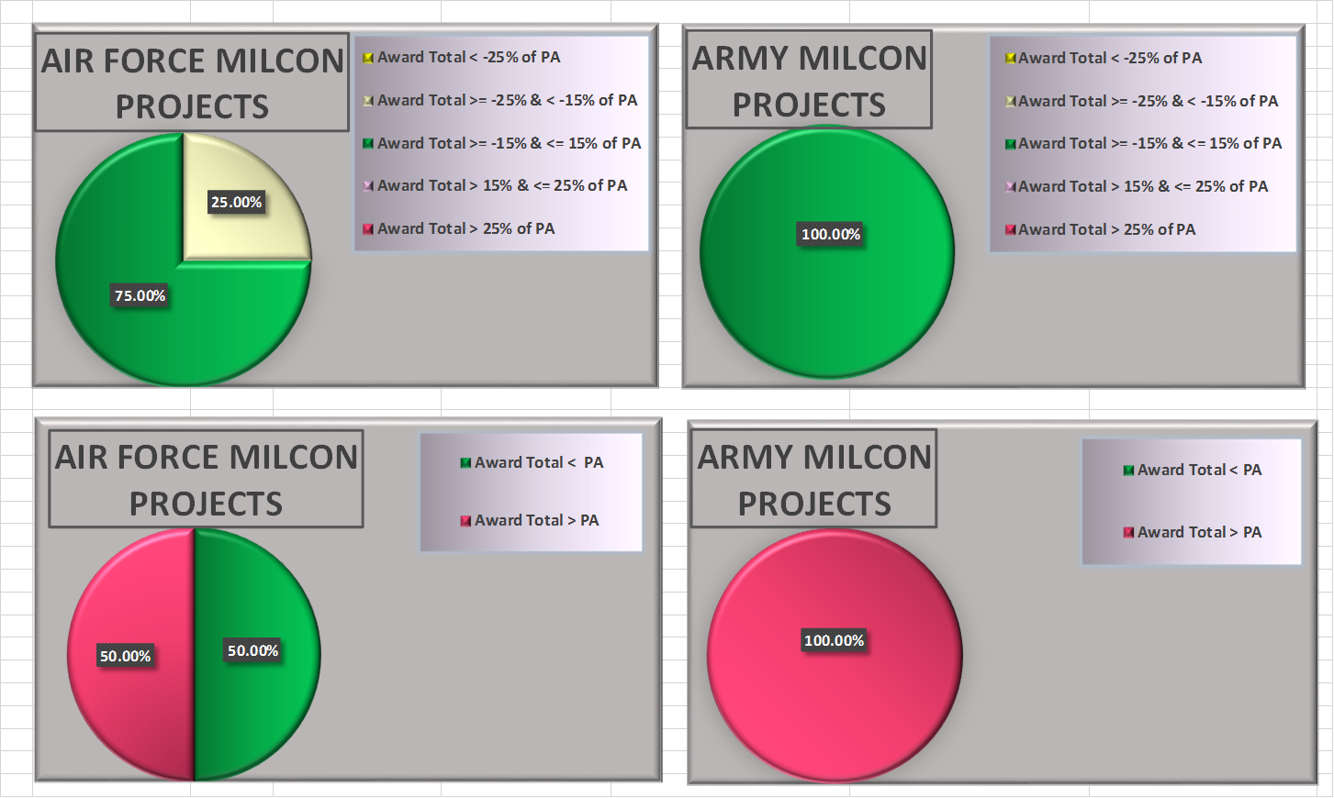
Results – award total vs. pa (cont.)

Slide 17
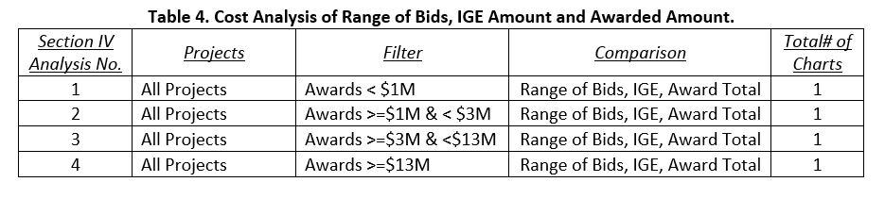
Results – section IV analysis
  The four analysis charts developed under this analysis were created to demonstrate the variability between the range of bids for each project. The estimates that don’t have a yellow bar chart shown only had a single bidder; therefore didn’t have a range of bids.

Slide 18
Results – range of bids (projects <$1M)

Slide 19
Results – range of bids (projects >=$1M & <$3M)

Slide 20
Results – range of bids (projects >=$3M & <$13M)

Slide 21
Results – range of bids (projects >=$13M)

Slide 22
Potential Root causes for ige related issues
Within Our Control
Estimating from a poorly written SOW
Lack of time to develop a detailed IGE
Lack of training and certifications
Lack of site visits
Lack of technical mentorship
Cost Engineer not involved early enough in the PDT
Lack of pertinent information from members of the PDT (amendments not sent to Cost Engineer, scope changes w/out Cost Engineer knowledge.
Lack of peer reviews, quality control and other best practices
Lack of proper market research
Estimating to the PA and not the SOW
Outside Our Control
  Bidding climate (supply/demand) and range of bids
  Lack of subcontractor competition
  Market conditions (natural disasters)
  Programmed Amounts and other historical programming documents are inaccurate
  Contractor risk (contractors must interpret the risk and be willing to accept the risk)
  Procurement method
  Cost Engineer experience level (retention)
  Base access
  Pool of qualified subcontractors (some specifications require highly specialized qualifications)
  Cost book latency (currently utilizing 2016 cost book)
  Equipment library latency (utilized 2014 for all of FY17, received 2016 in October 2017)

Slide 23
Conclusions and recommendations for cost engineering section
Early involvement in the DD 1391 process to influence PA’s
Involvement in the development of Area Cost Factors
Develop a robust quality control
Participate in site visits and design review meetings
Participate in proposal evaluations, discussions and negotiations
Document lessons learned, best practices and processes and policies
Regularly track market conditions (could involve partnering meetings w/industry or having proper resources)
Implement a cost schedule risk analysis (CSRA) process for MILCON projects

Slide 24
Conclusions and recommendations for cost engineering section
Develop cost metrics to determine areas of improvement
Change culture for in-house estimates and A-E contracts (estimate to the scope, not the PA)
Independent A-E for cost estimating services vs. design

Slide 25
Backup slides

Slide 26
Cost Estimating process for milcon project eng 3086/dd form 1391
DD Form 1391 Review and ENG 3086 Review/Update (Army Process) – Cost Engineer can update the ENG 3086 in PC-Cost. Cost Engineer can override the default unit prices that are pulled from the PAX/HAG data. When price overrides are used, the Cost Engineer must provide justification within the estimate located in PC-Cost. Once data is entered on the ENG 3086, the form is submitted by the Cost Engineer and automatically routed through various organizations.
In our experience, the Huntsville Center is the first organization to approve the ENG 3086 changes. Huntsville Center will usually submit several comments and go through numerous iterations of reviewing the ENG 3086 before they approve the form for the Programs Integration Division at USACE HQ. After USACE HQ approves the form, it is sent to ACSIM for validation; at which time we assume it is approved.
DD Form 1391 Review and ENG 3086 Review/Update (Air Force Process) – process currently unknown for SWT’s Cost Engineering Section. Feedback from the Air Force indicates that most of their projects are at the Above Threshold Reprogramming (ATR).
Typically, the Cost Engineer will review/validate the DD 1391 before or during the design charrette. Recently on the AIT Phase 2 Barracks project, the Cost Engineering Section was required to develop a contingency for 80% level of confidence of the project cost. This 80% level of confidence cost was documented in a memorandum for record. This process is new for MILCON projects that aren’t mega-projects and SWT is becoming more familiar with the process.

Slide 27
Cost Estimating process for milcon project
35% design Submittal
35% Design Submittal (if developed in-house):
  Primary Cost Engineer develops the WBS (or pricing/CLIN schedule) and enters the WBS into a new MII cost estimate as a starting point.
  Primary Cost Engineer begins documenting the MII cost estimate SOW and assumptions. These will continue to be updated through the development of the estimate.
  Cost Engineering Team Lead assigns development of the cost estimate quantity take-offs and pricing to the various engineering disciplines w/in the Cost Engineering Section.
  Start quantity take-offs by either reviewing the plans & specifications in a two dimensional view (in cases where BIM doesn’t exist) or in a three dimensional view if BIM exists. Quantity take-offs typically documented in spreadsheets and on the plans (and noted in the MII project item notes) and then given to Primary Cost Engineer.
  Pricing items involves various methods – the primary source of pricing is RS Means (however, the cost book is 2016), attempting market research through calling vendors and requesting quotes, or historical data (particularly for very unique projects like Hydropower).

Slide 28
Cost Estimating process for milcon project
35% design Submittal
35% Design Submittal (if developed in-house):
  Primary Cost Engineer copies the quantitates take-offs and pricing into the master MII cost estimate.
  Primary Cost Engineer adds prime contractor and subcontractors to the MII cost estimate and assigns them to the features of work.
  Primary Cost Engineer adds markups to the MII cost estimate.
  Primary Cost Engineer begins working through the SWT QAQC checklist to ensure everything is complete on the MII cost estimate.
  Upon completion of the QAQC checklist, the Primary Cost Engineer requests a peer review from another Cost Engineer on the team.

Slide 29
Cost Estimating process for milcon project
35% design Submittal
35% Design Submittal (if developed in-house):
  The peer review is conducted and comments are documented on the QAQC checklist and then addressed by the Primary Cost Engineer.
  The Primary Cost Engineer loads all cost estimate documents in ProjectWise.
  The Primary Cost Engineer sends the cost estimate (known as the current working estimate or CWE) to the Project Manager and Design Manager/Technical Manager.

Slide 30
Cost Estimating process for milcon project
65% design Submittal
65% Design Submittal (if developed in-house):
  Primary Cost Engineer further refines the WBS (or pricing/CLIN schedule) and updates the WBS into the existing MII cost estimate.
  Primary Cost Engineer documents additional or revised SOW and assumptions in the MII cost estimate. These will continue to be updated through the development of the estimate.
  Cost Engineering Team Lead assigns review/further development of the cost estimate quantity take-offs and pricing to the various engineering disciplines w/in the Cost Engineering Section. The assigned Cost Engineers will price the new items and pricing for other items to reflect current prices.
  Primary Cost Engineer copies the quantitates take-offs and pricing into the MII cost estimate.

Slide 31
Cost Estimating process for milcon project
65% design Submittal
65% Design Submittal (if developed in-house):
  Primary Cost Engineer adds any new information for the prime contractor and subcontractors to the MII cost estimate and assigns them to any new features of work.
  Primary Cost Engineer revises or adds markups to the MII cost estimate.
  Primary Cost Engineer begins working through the SWT QAQC checklist to ensure everything is complete on the MII cost estimate.
  Upon completion of the QAQC checklist, the Primary Cost Engineer requests a peer review from another Cost Engineer on the team.

Slide 32
Cost Estimating process for milcon project
65% design Submittal
65% Design Submittal (if developed in-house):
  The peer review is conducted and comments are documented on the QAQC checklist and then addressed by the Primary Cost Engineer.
  The Primary Cost Engineer loads all cost estimate documents in ProjectWise.
  The Primary Cost Engineer sends the cost estimate (known as the current working estimate or CWE) to the Project Manager and Design Manager/Technical Manager.
  NOTE: At this point the cost should be carefully examined and compared against the DD 1391. If the project cost is approaching more than 80% of the PA, design alternatives should be considered and documented as options. If the project cost is more than the PA, STOP and develop courses of action with all stakeholders. This information should be briefed to the District Commander for situational awareness.

Slide 33
Cost estimating process for milcon project
95% & 100% design Submittal
95% Design Submittal (if developed in-house):
  Same steps as 65% design submittal (final design for fire suppression and exact location of final electrical runs are left to construction contractors).
  NOTE: At this point the cost should be carefully examined and compared against the DD 1391. If the project cost is approaching more than 80% of the PA, design alternatives should be considered and documented as options. If the project cost is more than the PA, STOP and develop courses of action with all stakeholders. This information should be briefed to the District Commander for situational awareness.
100% Design Submittal (if developed in-house):
  Same steps as 65% design submittal.
  One additional step after step l and before step m is for the Primary Cost Engineer to request approval signatures for the IGE (no longer a CWE) from the Team Lead of Cost Engineering, the Chief of the Construction Management Section and the Chief of the Construction Division. The Primary Cost Engineer may be requested to make changes to the IGE before approval signatures.
  NOTE: At this point the cost should be carefully examined and compared against the DD 1391. If the project cost is approaching more than 90% of the PA, options or courses of actions should be documented and briefed to all stakeholders. If the project cost is more than the PA, STOP and develop courses of action with all stakeholders.

Slide 34
Cost estimating process for milcon project solicitation phase
Solicitation is issued (assuming we’ve received authority to advertise): Phase II of the Solicitation (if a two phase procurement).
Respond to RFIs and Issue Amendments as needed.
  Primary Cost Engineer should be sent a copy of the RFIs and amendments.
  Primary Cost Engineer will revise the IGE as needed and will need to get approval signatures again if the IGE was updated.
Proposals received.
NOTE: Theoretically at this point the Primary Cost Engineer should be finished with the IGE. In recent history; however, proposal costs have been significantly over the PA and require reprogramming or significant design changes in which case the design process could begin again at any point in the design process. The Primary Cost Engineer may also be requested to perform a cost/price analysis.

Slide 35
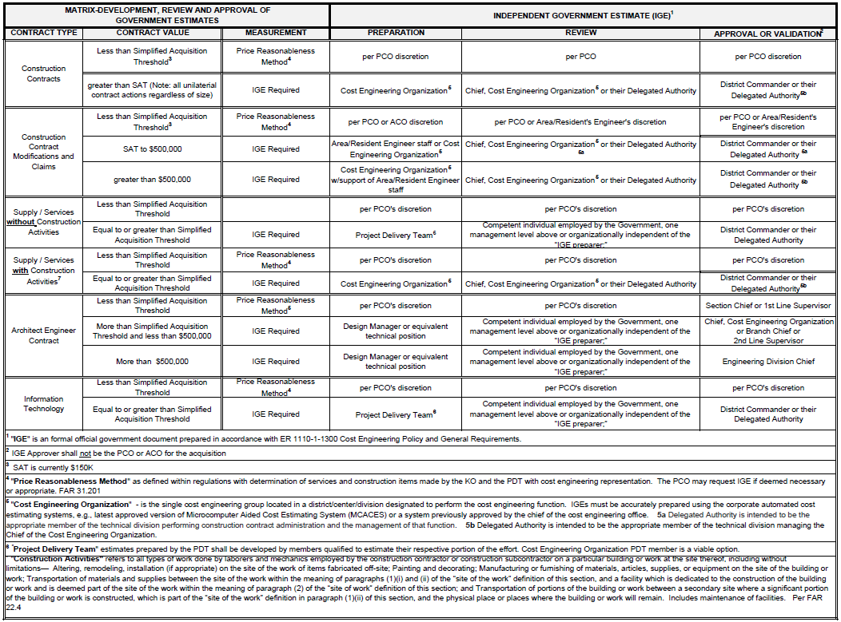
Usace desk guide: ige signatory matrix

Slide 36
IGE criteria
All Independent Government Estimates (IGEs) should be prepared in accordance with the criteria listed below:
  ER 1110‐1‐1300: Cost Engineering Policy and General Requirements
  UFC 3‐740‐05 Handbook: Construction Cost Estimating with Change 1
  EM 1110‐2‐1304: Civil Works Construction Cost Index System (CWCCIS)
  Additionally, HTRW Projects shall follow ER 1110‐3‐1301: Environmental Remediation and Removal Programs Cost Engineering
  Addionally, Civil Works Projects shall follow ER 1110‐2‐1302: Civil Works Cost Engineering
  Additionally, Military Projects follow ER 1110‐3‐130: Military Programs Cost Engineering; UFC 3‐730‐01: Programming Cost Estimates for Military Construction with Change 1 and UFC 3‐701‐01: DoD Facilities Pricing Guide
  USACE Acquisition Instruction (UAI) – Part 5107, 25 January 2017, subject: Acquisition Planning
  USACE Desk Guide, subject: Attachment 3. Independent Government Estimates Signatory Matrix

Slide 37
Cost Engineering district support
Independent Government Estimates
Design-Build Estimate
Design-Bid-Build Estimates
Modification Estimates
Parametric Estimates
Current Working Estimates (CWEs)
Feasibility Study Estimates
Other Cost Products
DD 1391 & ENG 3086 Validation
Budgeting for Civil Works Programs
Price Analysis
Price Objective Memorandums (POMs)
Price Negotiation Memorandums (PNMs)
Liquidated Damages
Weather Delays
Cost Support Services
A/E Estimate Reviews
Schedule Reviews
BCOES Reviews
Source Selection Evaluation Boards
Legal Support
Plans and Specifications Support
Design Review Support
Negotiation Support

Slide 38
Cost engineering professional development
ID | COURSE TITLE
181 | COST ESTIMATING BASICS
220 | COST RISK ANALYSIS BASIC
180 | ESTIMATING FOR CONSTRUCTION MODIFICATIONS
24 | CIVIL WORKS COST ENGINEERING
305 | MICRO-COMPUTER AIDED COST ESTIMATING SYSTEM II BASIC
312 | MICRO-COMPUTER AIDED COST ESTIMATING SYSTEM II ADVANCED
254 | BUDGET TRAINING
333 | DREDGING FUNDAMENTALS
118 | DREDGE COST ESTIMATING
4 | ARCHITECT-ENGINEER CONTRACTING
368 | NEGOTIATING CONSTRUCTION CONTRACT MODIFICATIONS
251 | APPLICATION OF ENGINEERING GEOLOGY
29 | CONSTRUCTION QUALITY MANAGEMENT
425 | DESIGN BUILD CONSTRUCTION
185 | SPECIFICATIONS FOR CONSTRUCTION CONTRACTS
115 | PAVEMENT EVALUATION AND DESIGN
21 | CONCRETE FUNDAMENTALS
257 | CONCRETE MAINTENANCE AND REPAIR
Tri-Service Cost Engineering Certification Program
Certification Eligibility:
Minimum of 4 years of verifiable cost engineering experience may apply for certification. This experience may consist of a minimum 2 years of college-level academic training or nine (9) Continuing education Units (CEUs) of Cost Engineering related training which, when combined with practical cost engineering experience of at least 2 years will result in a total of at least 4 full years.
http://www.usace.army.mil/Portals/2/docs/costengineering/Certification_ByLaws_06Sept14.pdf
Information:
http://www.usace.army.mil/Cost-Engineering/Cost-Engineering-Certification/

